Slide 1
SOF 103
C and C++ Programming
Chapter 7
Functions

Slide 2
Vision and Mission
Vision
Xiamen University Malaysia aspires to become a university with a distinct global outlook, featuring first-class teaching and research, and embracing cultural diversity.
Mission
To nurture young talents with dignity and wisdom, turning them into fine citizens of the region who will contribute to the prosperity of the people and social progress of Malaysia, China and Southeast Asia.
Compile by Dr. Hew

Slide 3
Functions
A function groups a number of program statements into a unit and gives it a name.
This unit can then be invoked (called) from other parts of the program.
Why we use functions?
  They make the program easy to understand
  Modular Programming: Divide a task into simple subtasks
  Reduce program size
  Use function calls in branching statements

Slide 4
Built-in Functions vs User Defined Functions
Built-in Functions OR Pre-defined Functions
  The functions provided by the language library. The programmer just call these functions in the program according to his requirement. for example,
  sqrt( );
  pow( );
  strcpy( );
  clrscr( ); etc.
User Defined Functions OR Programmer Defined Functions
  These are defined by the programmer to solve his particular requirement. These can be given any name like variables.

Slide 5
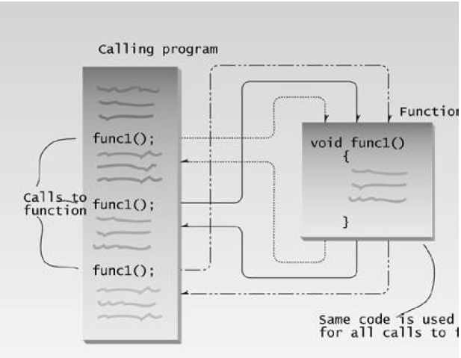
How function is invoked from different sections of a program

Slide 6
How To use a user defined function?
For a user defined function, we must know about the following things:
  Function prototype/declaration
  Function definition
  Function calling

Slide 7
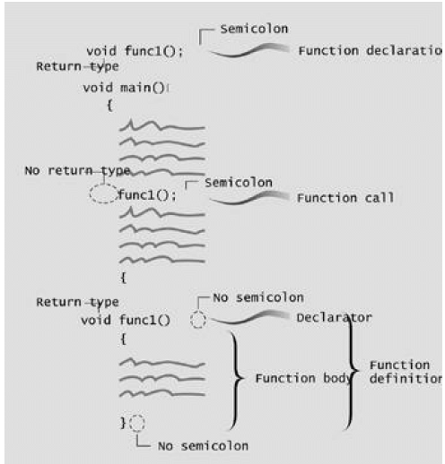
Function Declaration, Definition, and Calling

Slide 8
A program to demonstrate a function
#include<iostream>
using namespace std;
void starline(); //function declaration (Prototype)
int main()
{
starline(); //call to function
cout<<"Data type\tRange"<<endl;
starline(); //call to function
cout<<"char\t\t-128 to 127"<<endl
<<"short\t\t-32,768 to 32,767"<<endl
<<"int\t\tSystem dependent"<<endl
<<"long\t\t-2,147,483,648 to 2,147,483,647"<<endl;
starline(); //call to function
return 0;
}
void starline()
{
for(int j=0; j<45; j++)
cout<<"*";
cout<<endl;
}

Slide 9
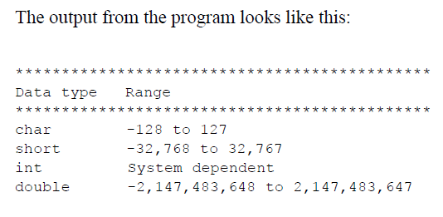
Output for P8

Slide 10
Passing Arguments to Function
An argument is a piece of data (an int value, for example) passed from a program to the function
Passing constants:
  As an example, lets suppose we decide that the starline() function in the last example is too rigid.
  Instead of a function that always prints 45 asterisks, we want a function that will print any character any number of times.

Slide 11
Function With Parameters
#include<iostream>
using namespace std;
void repChar(char, int); //function declaration (Prototype)
int main()
{
repChar('-', 43); //call to function
cout<<"Data type\tRange"<<endl;
repChar('=', 23); //call to function
cout<<"char\t\t-128 to 127"<<endl
<<"short\t\t-32,768 to 32,767"<<endl
<<"int\t\tSystem dependent"<<endl
<<"long\t\t-2,147,483,648 to 2,147,483,647"<<endl;
repChar(‘*’, 83); //call to function
return 0;
}
void repChar(char ch, int n)
{
for(int j=0; j<n; j++)
cout<<ch;
cout<<endl;
}

Slide 12
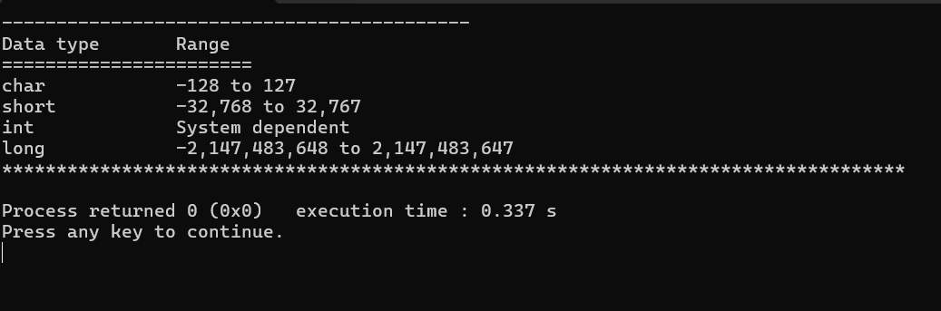
Output for P11

Slide 13
Passing Variables to a Function
#include<iostream>
using namespace std;
void repChar(char, int); //function declaration (Prototype)
int main()
{
char ch;
int n;
cout<<"\nEnter a character: ";
cin>>ch;
cout<<"\nEnter number of times to repeat it: ";
cin>>n;
repChar(ch, n); //call to function
return 0;
}
void repChar(char ch, int n)
{ // function definition
for(int j=0; j<n; j++)
cout<<ch;
cout<<endl;
}

Slide 14
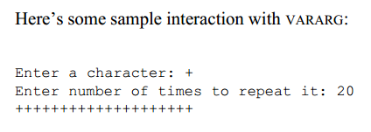
Output for P13

Slide 15
Returning Values from Functions
When a function completes its execution, it can return a single value to the calling program.
Usually this return value consists of an answer to the problem the function has solved.

Slide 16
Pound to Kilogram Functions
#include<iostream>
using namespace std;
float lbsToKg(float); //function declaration (Prototype)
int main()
{
float lbs, kg;
cout<<"\nEnter your weight in pounds: ";
cin>>lbs;
kg=lbsToKg(lbs); //call to function
cout<<"\nYour weight in kilogram : "<<kg<<endl;
return 0;
}
float lbsToKg(float pounds) // function definition
{
float kilograms=0.453592 * pounds;
return kilograms;
}

Slide 17

Output for P16

Slide 18
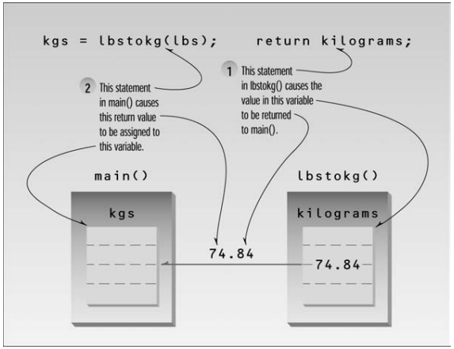
Cont…

Slide 19
Eliminating Unnecessary Variables
The CONVERT program contains several variables that are used in the interest of clarity but are not really necessary.
A variation of the CONVERT.cpp program is shown on the next slide:

Slide 20
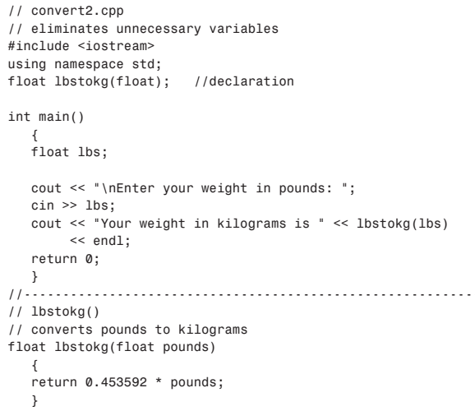
Eliminating Unnecessary Variables: Cont…

Slide 21
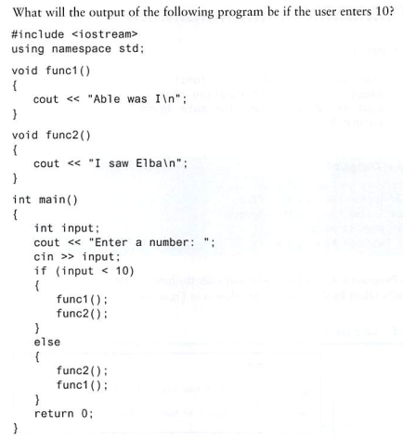
Checkpoint-1

Slide 22
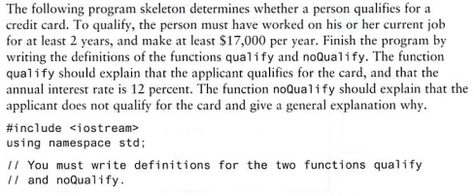
Checkpoint-2

Slide 23
Checkpoint-2, Cont…
int main()
{
double aSalary;
int yr;
cout<<"\nThis program woll determine if you qualify\n ";
cout<<"for our credit card.\n";
cout<<"What is your annual salary? ";
cin>> aSalary;
cout<<"How many years have you worked at";
cout<<"current job? ";
cin>>yr;
if(aSalary>=17000 && yr>=2)
{
qualify();
}
else
{
noQualify();
}
return 0;
}
#include<iostream>
using namespace std;
void qualify() //function declaration (Prototype)
{
cout<<"Qualify for the card, and the interest rate is 12%\n";
}
void noQualify() //function declaration (Prototype)
{
cout<<"No qualify! Annual income < $17,000\n";
}

Slide 24
Parameters Passing Mode
When calling a function, the parameters are passed as arguments to the function.
There are two ways of passing the arguments:
  By values – this is the what we have been using in the examples from the previous slides. In call-by-value function call, a copy of the argument’s value is made and passed to the called function. Changes to the copy do not affect the original variable’s value in the caller.
  By reference – the caller gives the called function the ability to directly access the caller’s data, and to modify that data if the called function so chooses. It is done by including an ampersand (&) symbol after the argument’s type in the function protoype.

Slide 25
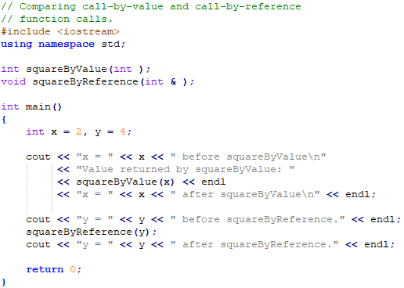
Example to demonstrate call-by-value and call-by-reference

Slide 26
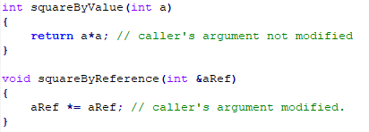
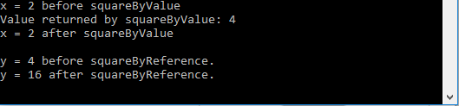
Example (Continued)

Slide 27
Call-by-reference
Call-by-reference can be done in two different ways:
  Call-by-reference with reference arguments (shown in previous example)
  Call-by-reference with pointer arguments
Just like passing an address/reference as arguments, pointers can also be passed as arguments.
Pointers, like references, also can be used to modify one or more variables in the caller, or to pass pointers to large data objects to avoid overhead of passing objects call-by-value.

Slide 28
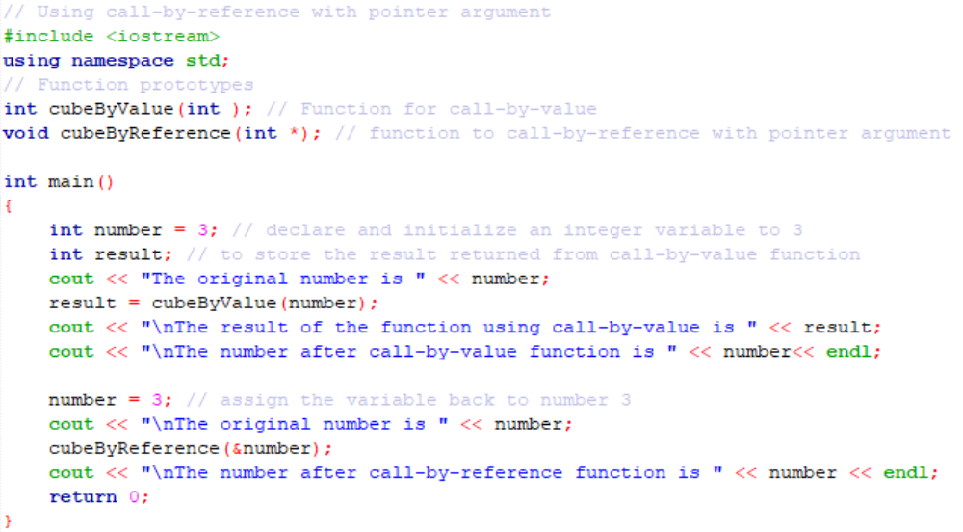

Example of call-by-reference with pointer argument
Code continue in the next slide.

Slide 29
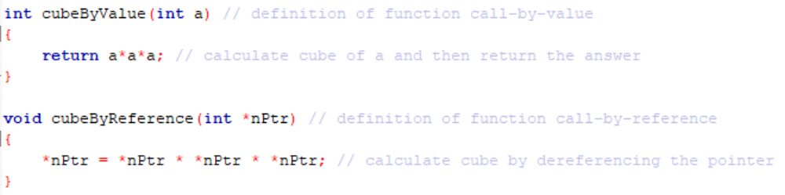
Example (Continued)
Code continued from the previous slide.

Slide 30
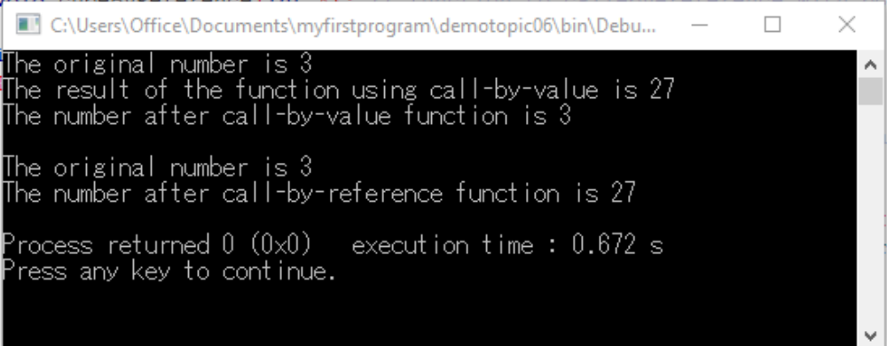
Output of the example program using call-by-reference with pointer argument

Slide 31
Pass by Reference
A reference provides an alias—a different name—for a variable. One of the most important uses for references is in passing arguments to functions.
Pass by reference mechanism actually passes the memory address of the variable, although you don’t need to know this.
An important advantage of passing by reference is that the function can access the actual variables in the calling program.
Among other benefits, this provides a mechanism for passing more than one value from the function back to the calling program.

Slide 32
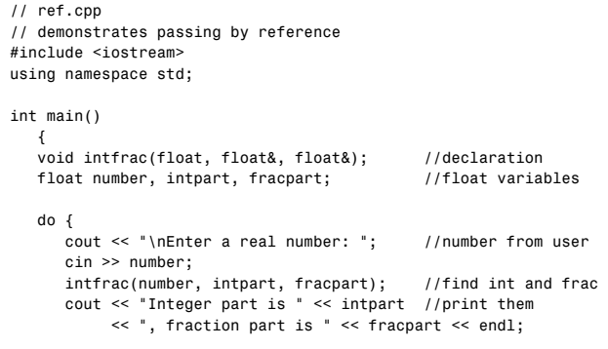
Pass by Reference – Example

Slide 33
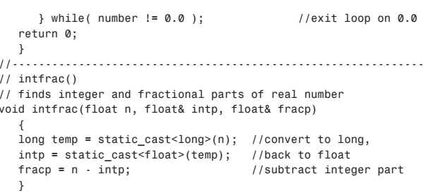
Cont…
Note: Suppose the input is 25.44, some compilers may generate spurious digits in the fractional part, such as 0.440002. This is an error in the compiler’s conversion routine and can be ignored.

Slide 34
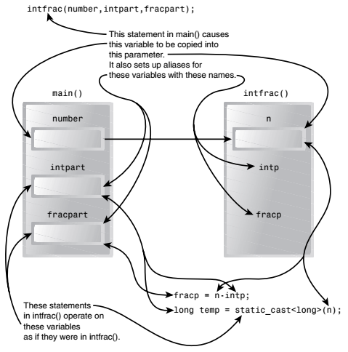
Cont…

Slide 35
A More Complex Pass by Reference
Suppose you have pairs of numbers in your program and you want to be sure that the smaller one
always precedes the larger one.
To do this you call a function, order(), which checks two numbers passed to it by reference and swaps the originals if the first is larger than the second.

Slide 36
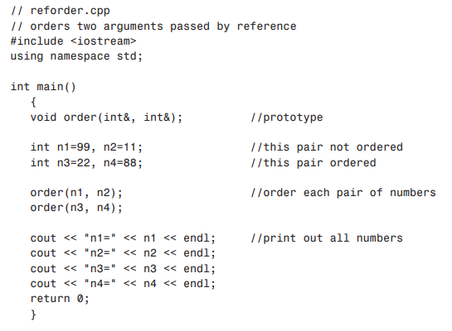
Cont…

Slide 37
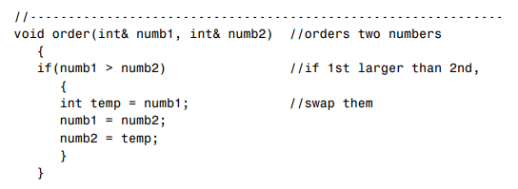
Cont…

Slide 38
Different Number of Arguments or
Function Overloading
Recall the series of starline() functions
The names of the defined functions were different, i.e., starline(), repchar() etc.
It would be convenient to use the same name for those different functions, even though they have different arguments

Slide 39
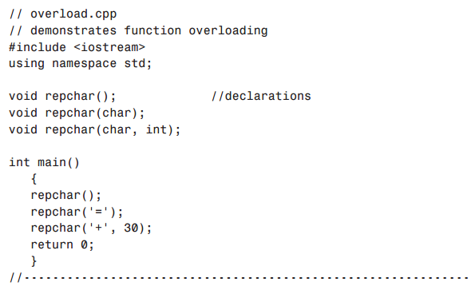
Cont…

Slide 40
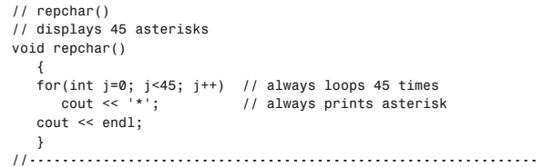
Cont…
Defining void repchar()

Slide 41
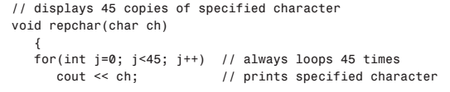

Cont…
Defining repchar(char)

Slide 42
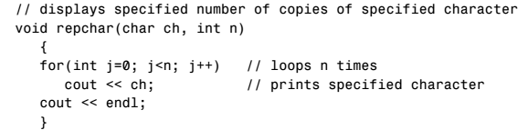

Cont…
Defining repchar(char, int)
Program Output:

Slide 43
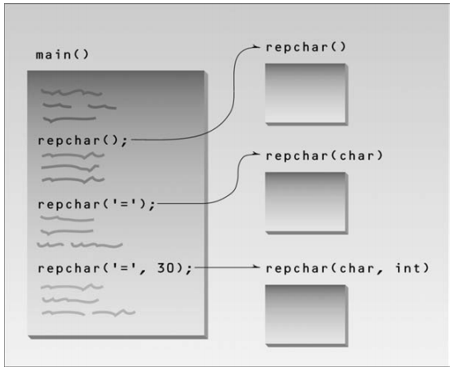
Cont…

Slide 44
Recursion
The existence of functions makes possible a programming technique called recursion.
Recursion involves a function calling itself.
This sounds rather improbable, and indeed a function calling itself is often a bug. However, when used correctly this technique can be surprisingly powerful.

Slide 45
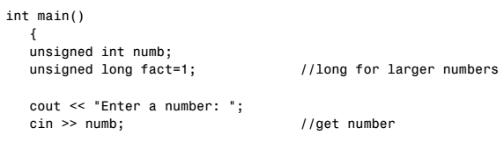
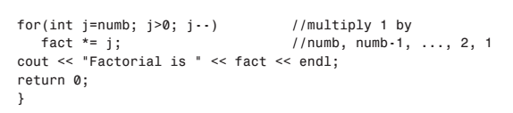
Factorial Program without Recursion

Slide 46
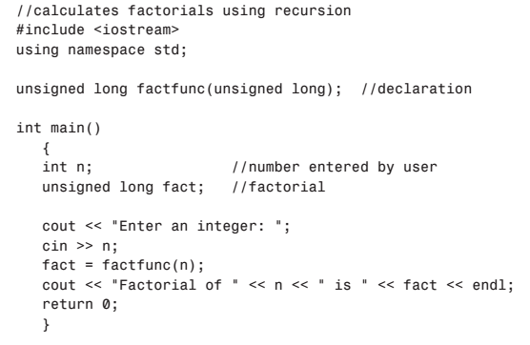
Factorial Program with Recursion

Slide 47
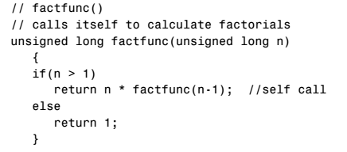
Cont…

Slide 48
Passing Arrays to Functions
To pass an array argument to a function, specify the name of the array without any brackets. E.g.
int arr[10];
The following function call statement passes array arr and its size to function modifyArray
modifyArray(arr, 10);
The size of an array is usually passed so that the function can process the specific number of elements in the array.

Slide 49
Passing Arrays to Functions (Continued)
Arrays are not passed using the ampersand operator ‘&’ because the name of the array is itself an address and the starting location of an array in the memory
For example, the name of an array arr is equivalent to &arr[0]. The name of the array is already a pointer.

Slide 50
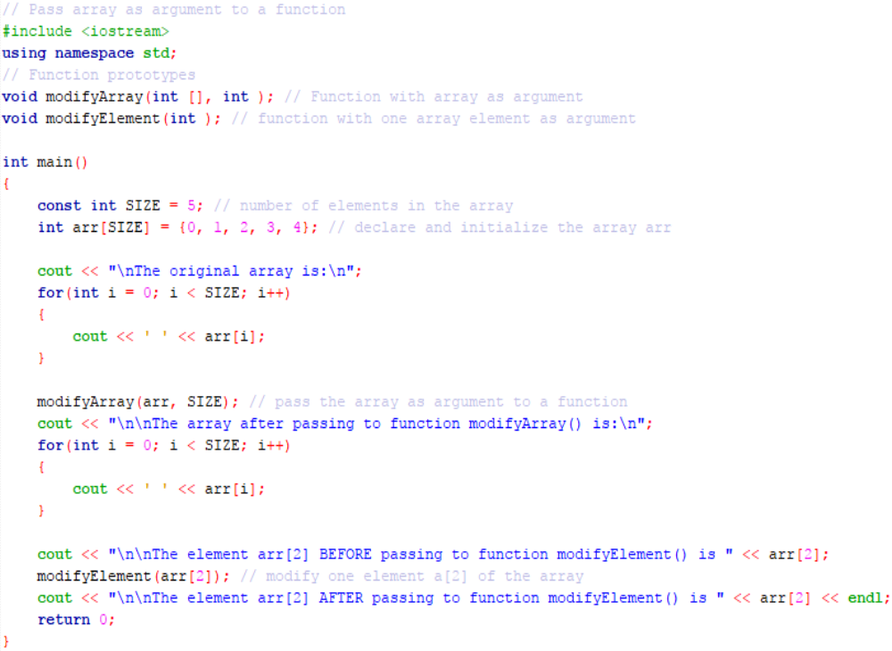

Slide 51
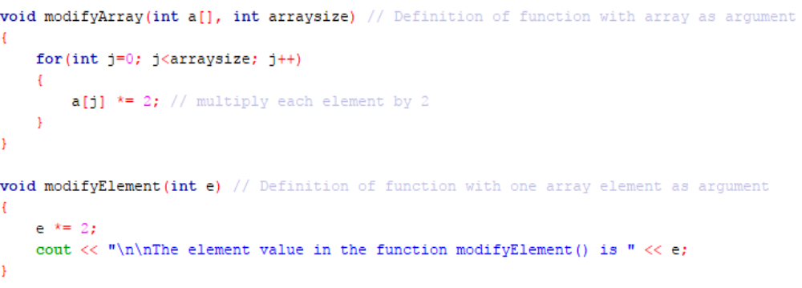
Cont…

Slide 52
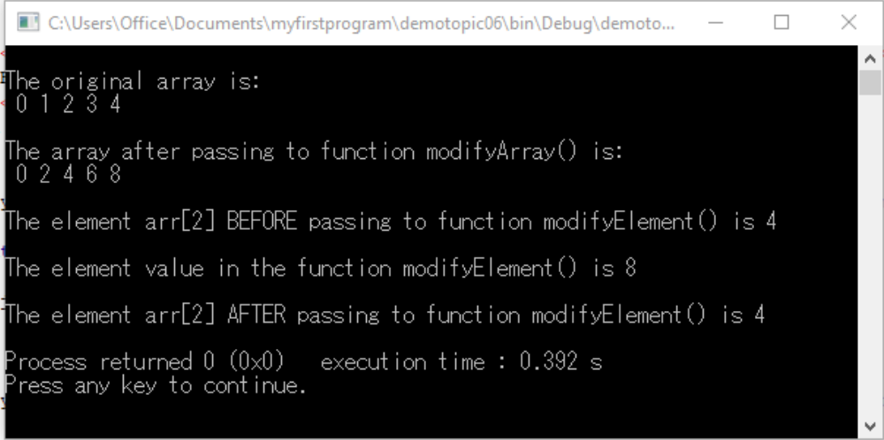
Program Output

Slide 53
References
Problem Solving with C++ (10th Edition), Walter Savitch, Addison Wesley, 2018
https://www.programiz.com/cpp-programming
Turbo C programming for the PC, Robert Lafore
Dr.Kamran’s notes
https://www.youtube.com/c/Codearchery

